Slide 1
Evaluate the impact of quarterly earnings report on stock price movement
6883 Financial Computing
Yusheng Chen
Levi Lan
Yuhsing Chang
Donguk shin
Tommy Hu
Stanley Sukanto

Slide 2
Task
Allocation
Container.hpp/ .cpp: Levi
Gnuplot.hpp: Stanley
Helper.hpp/ .cpp: Yuhsing & Yusheng
LoadData.hpp: Tommy & Yusheng
Stock.hpp/ .cpp: Levi
main.cpp: Donguk & Yusheng

Slide 3
Executive Summary
Analyze the impact of earning announcement from 2277 stocks, from January 2021 to March 2022, looking at the change in stock prices N days before and after the announcement. The impact is evaluated based on the surprise percentage calculated using predicted earning and actual earning.
Calculation, 40 times and taken the average:
4 metrics and their graphs: AAR, AAR STD, CAAR, CAAR STD

Slide 4
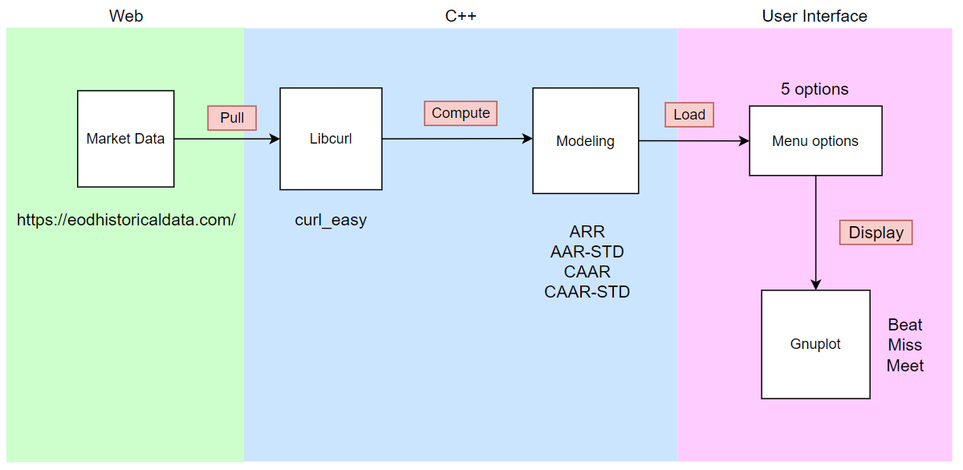
Project Design (UML)

Slide 5
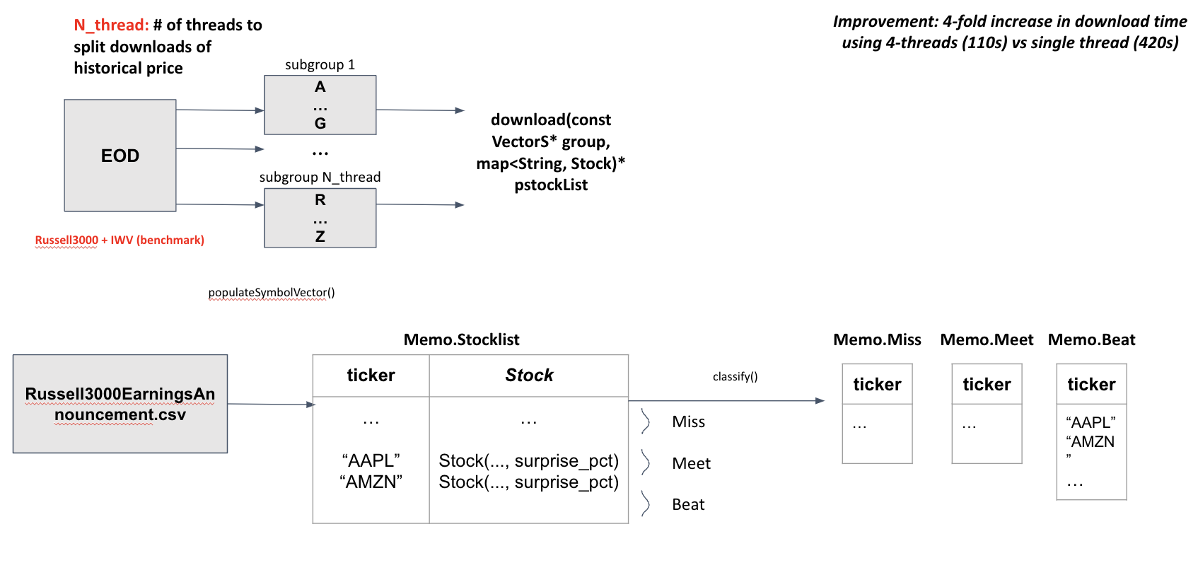
Data Part

Slide 6
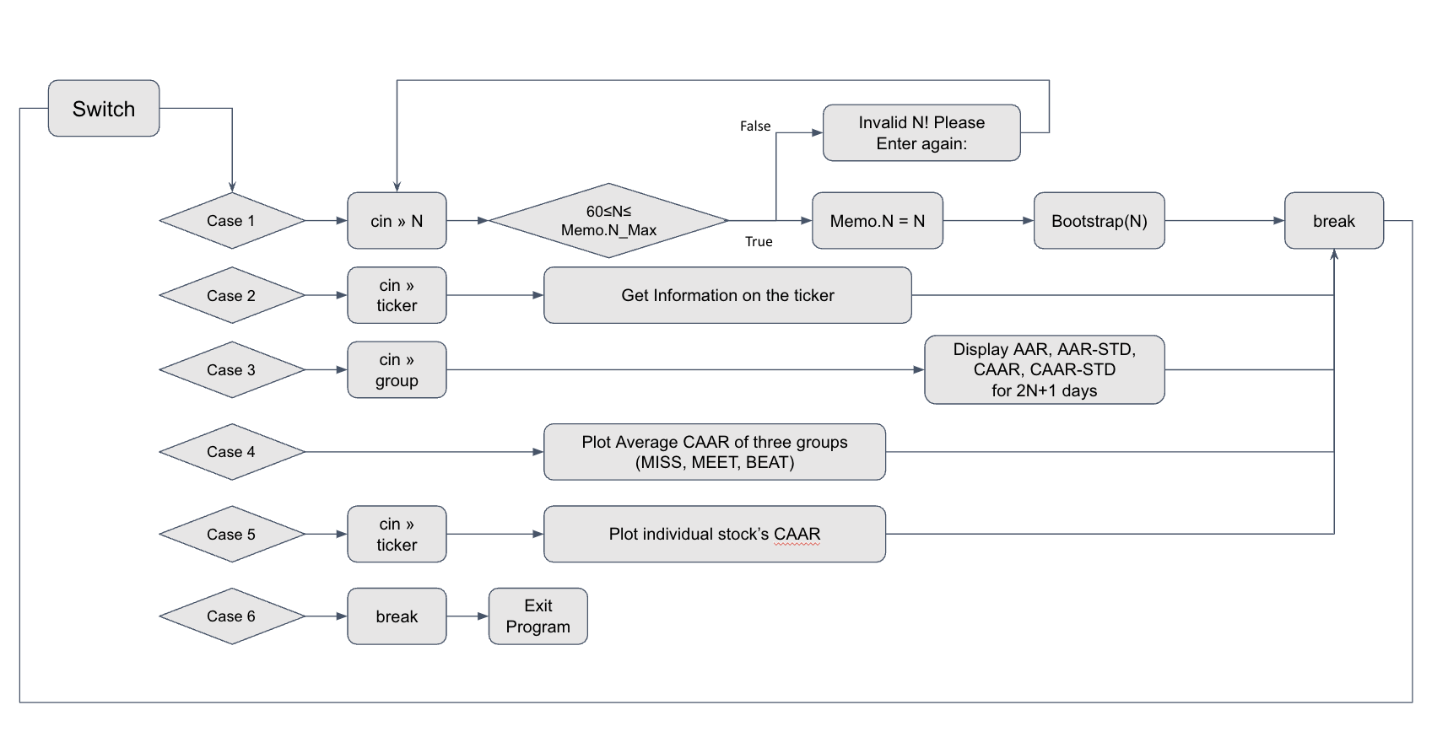
Menu

Slide 7
Data Structure
Container.hpp / Container.cpp
4 kinds of Data Structures
Vector of String VectorS = vector<string> Vector of double VectorD = vector<double> 2D Matrix Matrix2D = vector<VectorD> 3D Matrix Matrix3D = vector<Matrix2D>
Overloading 5 operators & sqrt function
VectorD operator+(const VectorD& vt1, const VectorD& vt2) VectorD operator^(const VectorD& vt, int n); VectorD& operator+=(VectorD& vt1, const VectorD& vt2); VectorD& operator+=(VectorD& vt, double n); VectorD operator-(const VectorD& vt1, const VectorD& vt2); VectorD operator-(const VectorD& vt1, double n); VectorD operator/(const VectorD& vt, double n); Matrix3D operator/(const Matrix3D& vt, double n); VectorD sqrt(const VectorD& vt);

Slide 8
Stock Class - Data
Stock.hpp
Access Specifier | Member data | Definition | How to get value?
public | String earn_ann_date_ String period_ending_ double estimated_earn_ double reported_earn_ double surprise_ double surprise_pct_ |  | Retrieved from EOD through populateSymbolVector() (see LoadData.cpp))
 | Int earn_ann_date_index | The index of the position where the stock price on the earning announcement date is stored in daily_price_ | Defined in download() (see LoadData.cpp)
 | Bool valid_ | Validate if the stock has enough data to be randomly selected to conduct bootstrapping
 | Group group_ | Beat, Meet, Miss or NA (for IWV only) | Defined in classilfy() (see Helper.cpp)
 | VectorD daily_price_ inline static Vector date_ |  | Retrieved from EOD through download() (see LoadData.cpp)
 | VectorD daily_ret_ VectorD cumulative_ret_ |  | Calculated by member functions
enum Group { MISS, MEET, BEAT, NA };
define and declare in hpp file

Slide 9
Stock Class -Operations
Stock.hpp / Stock.cpp
Access Specifier | Member Function | Signature | Functionality
public | Default constructor | Stock(): earn_ann_date_index_(0), estimated_earn_(0.0), reported_earn_(0.0), surprise_(0.0), surprise_pct_(0.0), valid_(false), group_(NA)
 | Constructor w/ parameter | Stock::Stock(std::string earn_ann_date, std::string period_ending, double estimated_earn, double reported_earn, double surprise, double surprise_pct)
 | Functions | calculate_returns() | Calculate daily_ret_ and culmulative_ret_ for all daily data and update the corresponding member data
 |  | calculate_returns(int N) | Calculate daily_ret_ and culmulative_ret_ from -(N-1) to N days and update the corresponding member data
 | Overloading operator << | std::ostream& operator<<(std::ostream& out, Stock& stock) | Print out all stock info, including price, cumulative return, group, earning announcement date, period ending,,... etc.

Slide 10
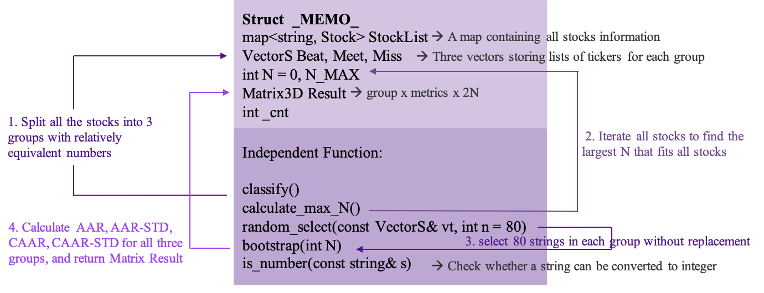
Helper.hpp/.cpp For AAR & CAAR calculation and other helping functions
Notes:
This Struct wrap all global variables.
Classify function split all the stocks into 3 groups with relatively equivalent numbers depending on their percentage of surprise. Through sorting the percentage of surprise, we can classify stocks into 3 groups.
Calculate_max_N: . Iterate all stocks to find the largest N that fits all stocks. So it means that the maximum N that customers can choose.
is_number(const string& s): Check whether a string can be converted to integer
Assume c is digit-> !isdigit= false -> return s.end()--> s.end()==s.end() true && !s.empty() also true --> bool true

Slide 11
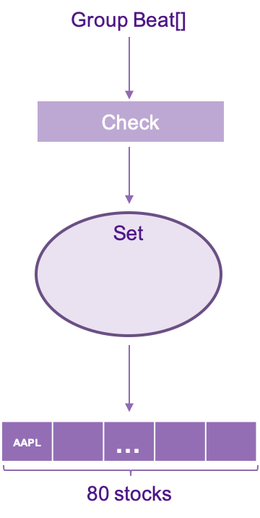
Random Select
1. Select stocks by index:
In each VectorS (ex: Beat) , using rand() to generate a random variable and taking its remainder by dividing its group size. (ex: Beat[rand()%m], m is size of group Beat)
2. Check validity and no repetition
If the selected ticker is valid and isn’t selected before, then insert this ticker into a set.
3. Keep selecting stocks until that the set have 80 tickers of stocks.
4. Return vector of string (ex: VectoS( set.begin(), set.end() ) )

Slide 12
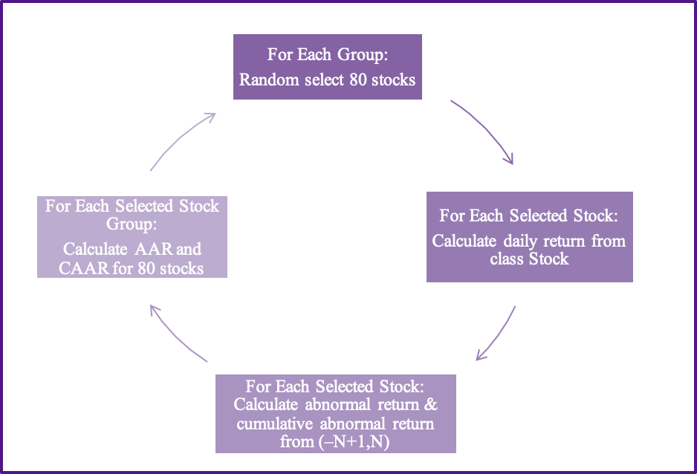
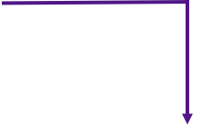
Bootstrap
Repeat 40 times:
Calculate Average AAR and CAAR
Calculate AAR-STD and CAAR-STD
Return a 3-D Matrix
(Group x 4 Metrics x 2N)

Slide 13
Complexity Analysis
Load Data
* S is the number of symbols
Read from csv ➝ O ( S ) , 16 ms
Classification ➝ O ( S log S ) , 4 ms
Download using Libcurl ➝ O ( S ) , 120 secs (4 threads)
* 150 ms + 3 ms (each stock)
Bootstrap
* N is the user input for bootstrapping
Random Selection ➝ O( 80 )
Calculate R, CR, AR, CAR ➝ O ( N )
Compute Average and STD of AAR, CAAR ➝ O ( N )
Total Complexity ➝ O( 40 x 3 x 80 x 2N x (2/4 + 2) )
Approximate running time ➝ N / 6 secs

Slide 14
Complexity Analysis
Current Method
Store daily returns & cumulative returns for each stock
Approximate running time ➝ 100 + 10 x M (s)
* M is the number of entering N
Alternative Method
Store 1. daily returns 2. cumulative returns 3. abnormal returns 4. cumulative anormal returns for each stock upfront
Extra space ➝ O ( S x 2 x 313 )
Approximate running time ➝ 130 + 1 x M (s)

Slide 15
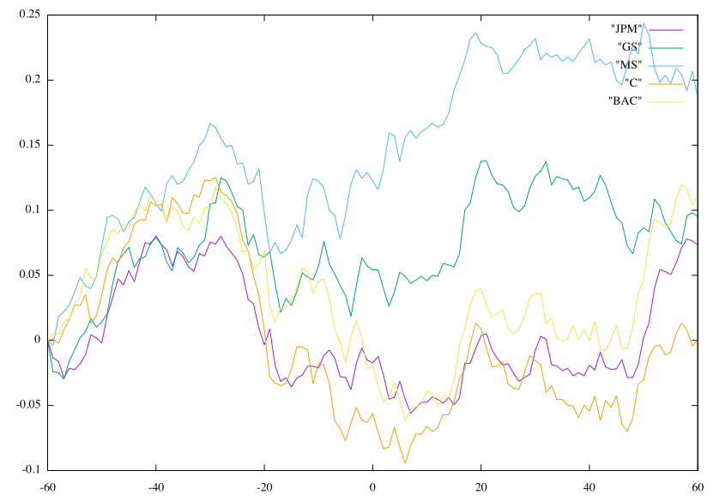
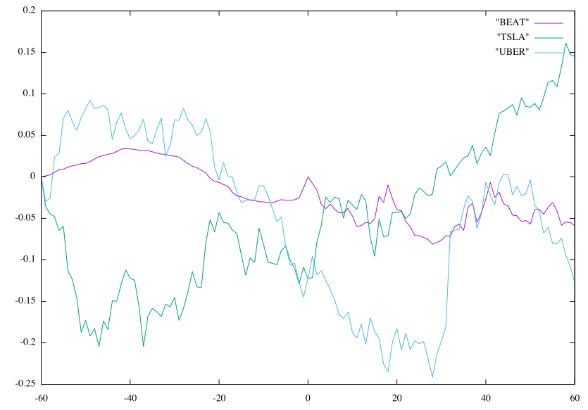
Additional Functionality
― Compare individual stock(s)
• Stocks within the same sector
• Stocks within the same group

Slide 16
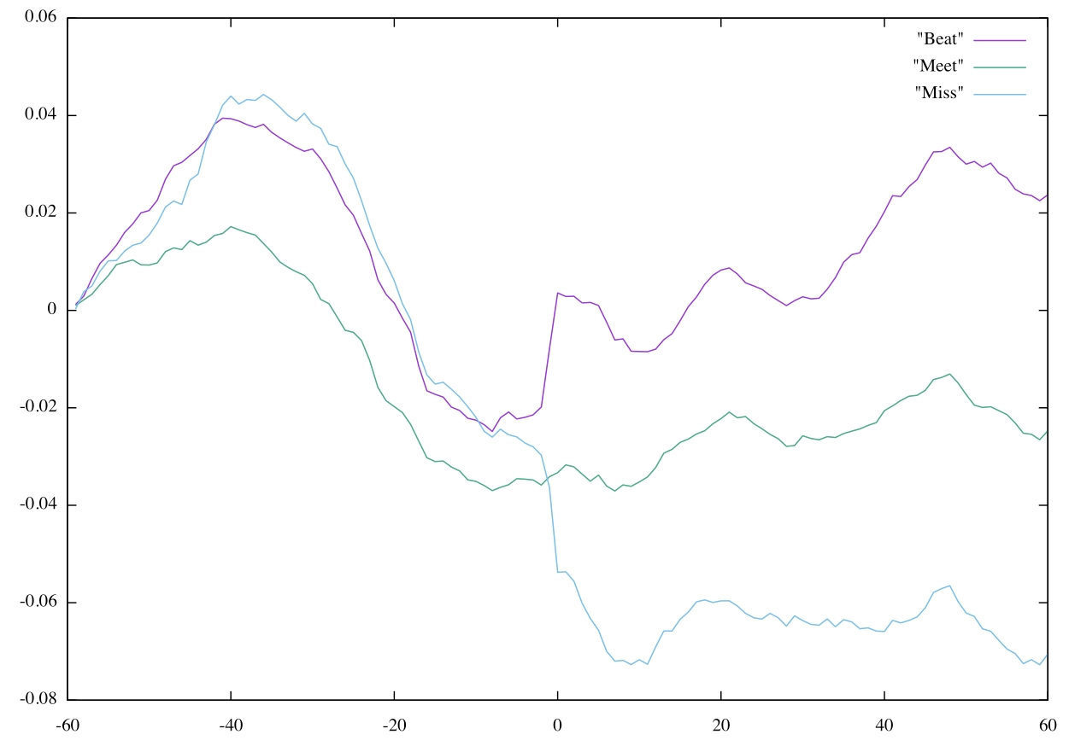
Gnuplot result

Slide 17
Explanation
Beat Group: The stock prices decreased before earning announcement day and rose right after announcement day and increased over time.
Meet Group: The stock prices decreased before earning announcement day and showed stable movement after the announcement day.
Miss Group: The stock price moved similarly to other two groups before earning announcement day but after decreased significantly and didn’t recover.

Slide 18
Conclusion
This graph means a lot!
While three groups move similarly before earning announcement day, there’s huge difference after the announcement day.
Therefore, historical earning performance can help investors understand and predict how the stock reacts to earning announcement.
Notes:
Stock prices in all three groups moved similarly before earning announcement day. They tend to decrease before the announcement day. However, Beet group stock prices tend to go up and we can guess this is because of their good performance last quarter. For Meet group, stocks seem stable after announcement day since there’s no big difference from market’s expectation, no shock. Lastly, for Miss group, stock prices dropped, performed worse than the market, leading to decrease in the CAAR.

Slide 19
Reference Slide
Topic 10 Working with Historical & Market Data, Tong Song
Multithreading in C++ https://www.geeksforgeeks.org/multithreading-in-cpp/

